Slide 1

ONLINE CRIME REPORTING
SYSTEM
(OCRS)
SUBMITTED BY :
SIBA PRASAD MAHARANA
ANWESH KUMAR PRADHAN
SUBHAM PRAKASH SWAIN

Slide 2
OBJECTIVE :
THE MAIN OBJECTIVE OF THE PROJECT ON ONLINE CRIME REPORTING SYSTEM IS TO MANAGE THE DETAILS OF CRIME, CRIMINAL, POLICE DEPARTMENT, PUBLIC, COMPLAINT. IT MANAGES ALL THE INFORMATION ABOUT CRIME, SOLUTIONS, COMPLAINT, CRIME. THE PROJECT IS TOTALLY BUILT AT ADMINISTRATIVE END AND THUS ONLY THE ADMINISTRATOR IS GUARANTEED THE ACCESS. THE PURPOSE OF THE PROJECT IS TO BUILD AN APPLICATION PROGRAM TO REDUCE THE MANUAL WORK FOR MANAGING THE CRIME, CRIMINAL, SOLUTIONS, POLICE DEPARTMENT. IT TRACKS ALL THE DETAILS ABOUT THE POLICE DEPARTMENT, PUBLIC, COMPLAINT.

Slide 3
SOFTWARE / HARDWARE USED:
HARDWARE USED :
▪ Processor intel i5 11 gen
▪ Ram 8GB
▪ Monitor
▪ Keyboard and Mouse
SOFTWARE USED :
▪ Operating System - Windows 11
▪ Developing Tool – VS code
▪ Language - PHP
▪ Database - MySQL
▪ Server-Xampp

Slide 4
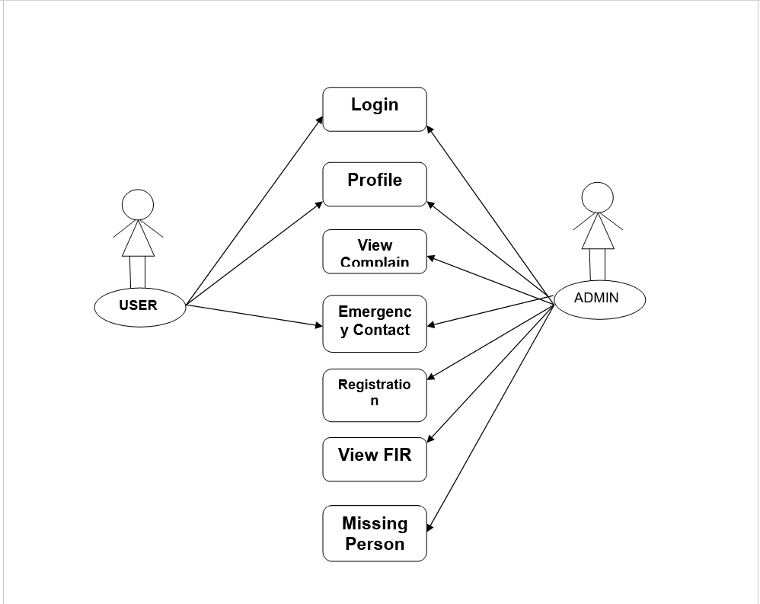
FLOW CHART

Slide 5
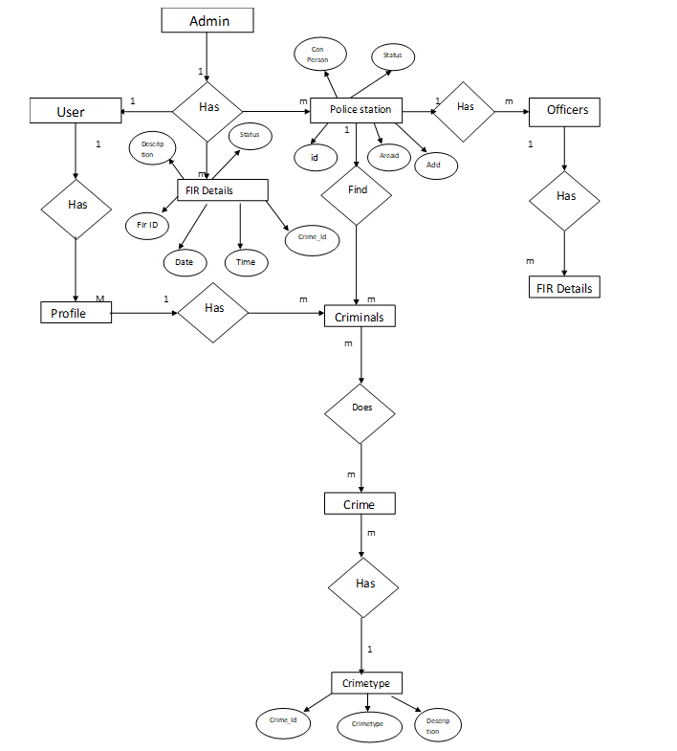
ER DIAGRAM

Slide 6
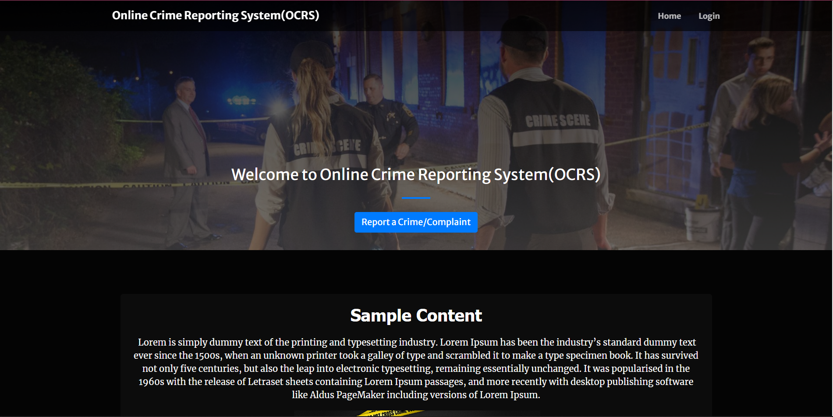
INDEX PAGE

Slide 7
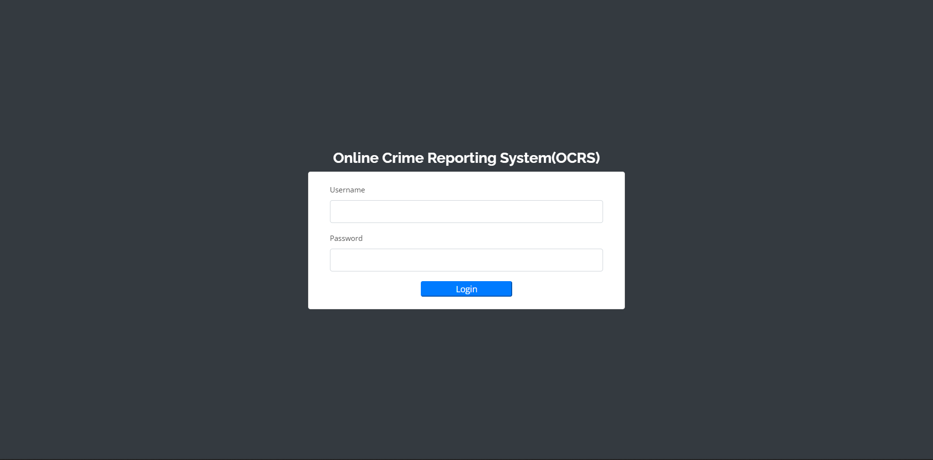
ADMIN LOGIN PAGE

Slide 8
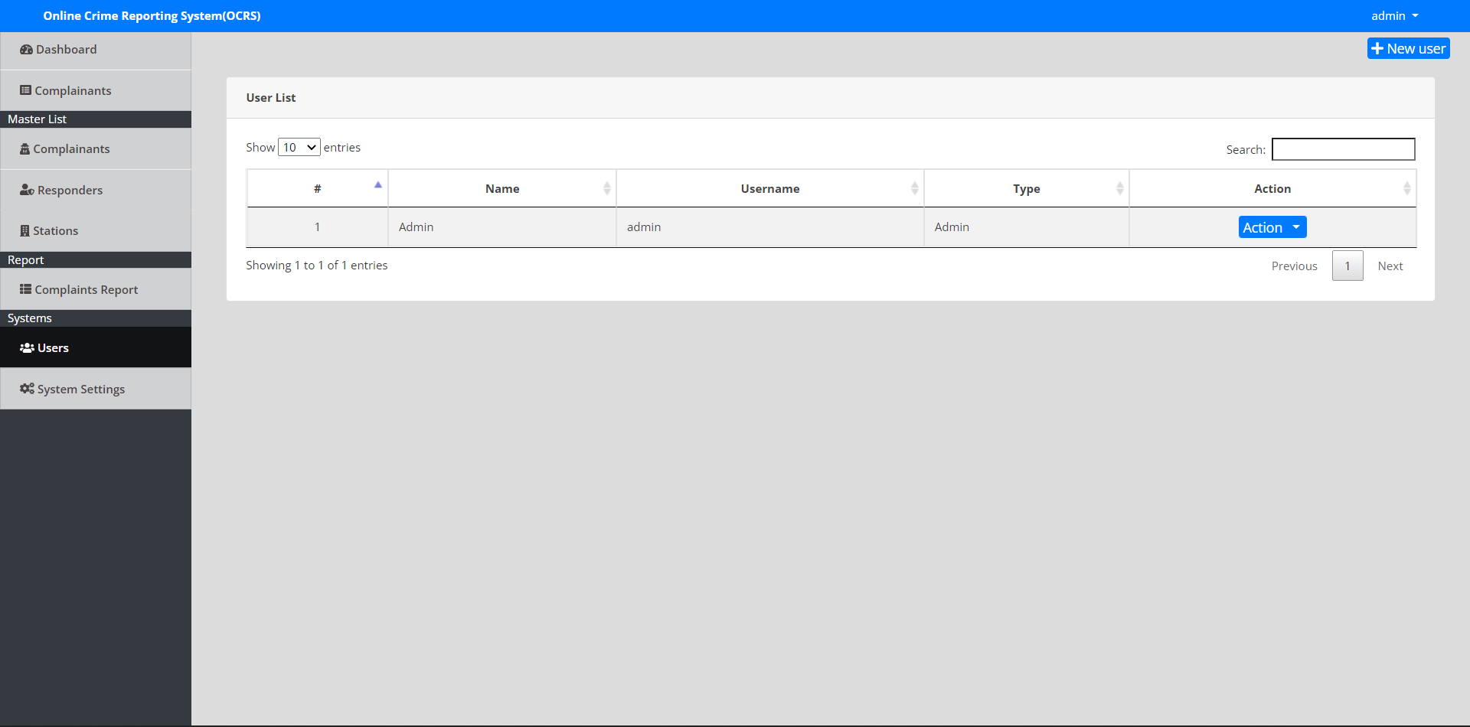
ADD USERS AND STAFFS

Slide 9
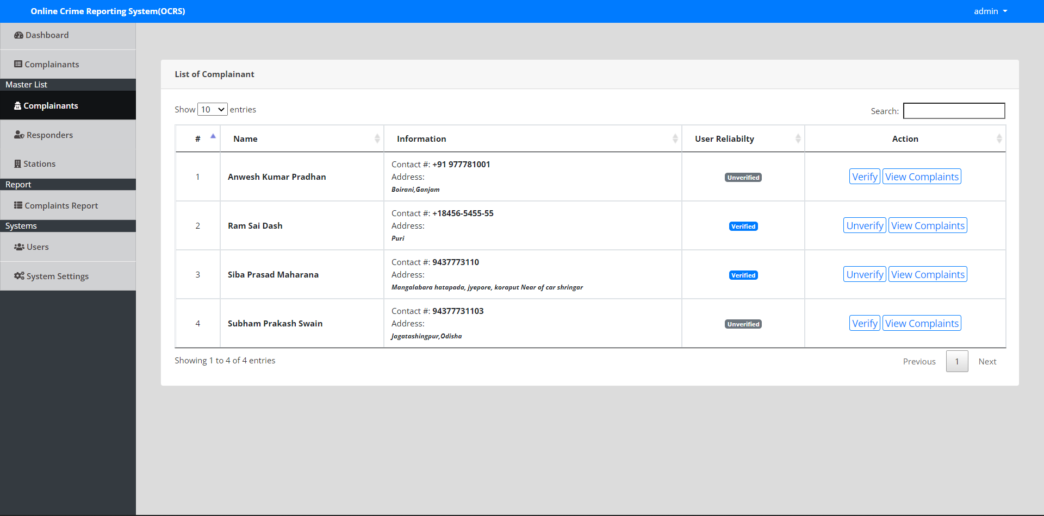
COMPLAINTANTS

Slide 10
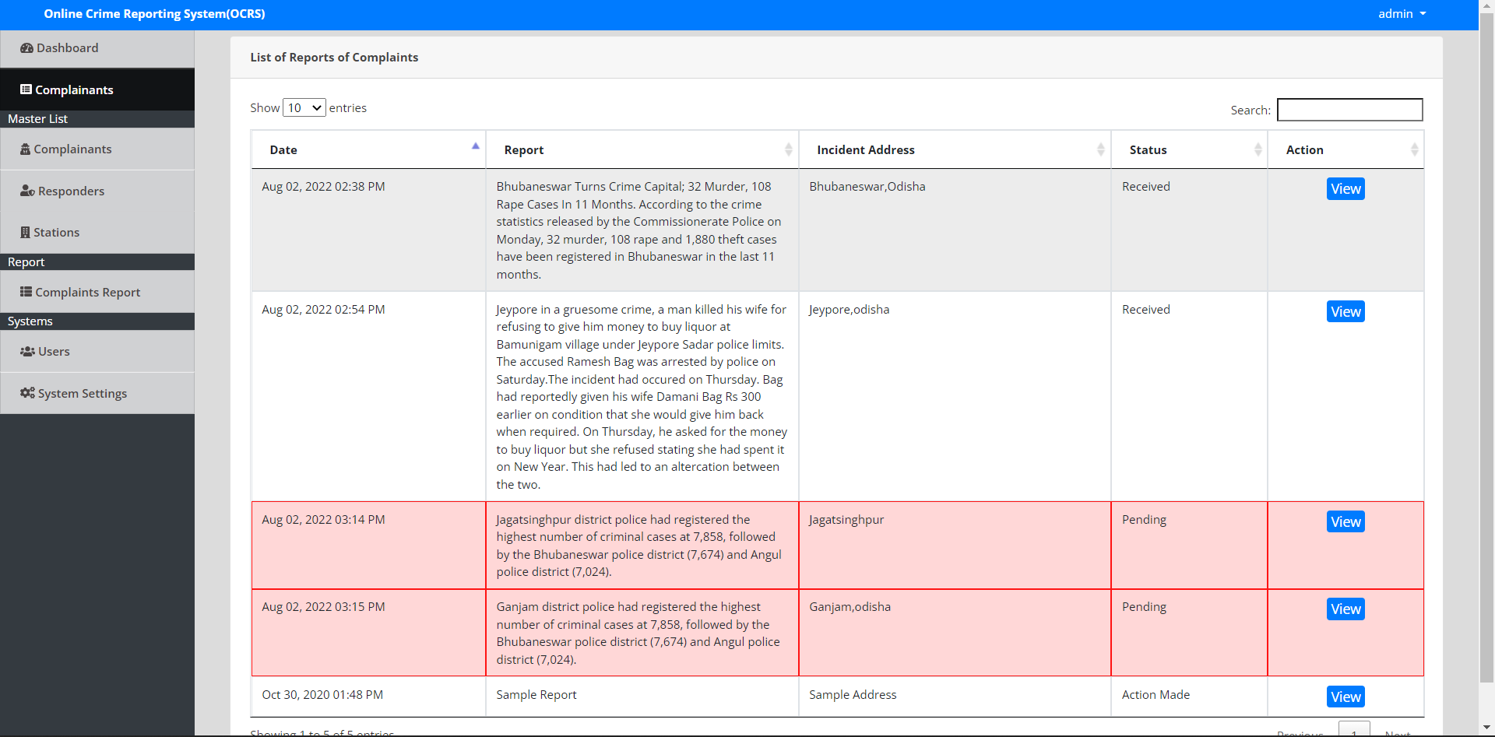
COMPLAINTS

Slide 11
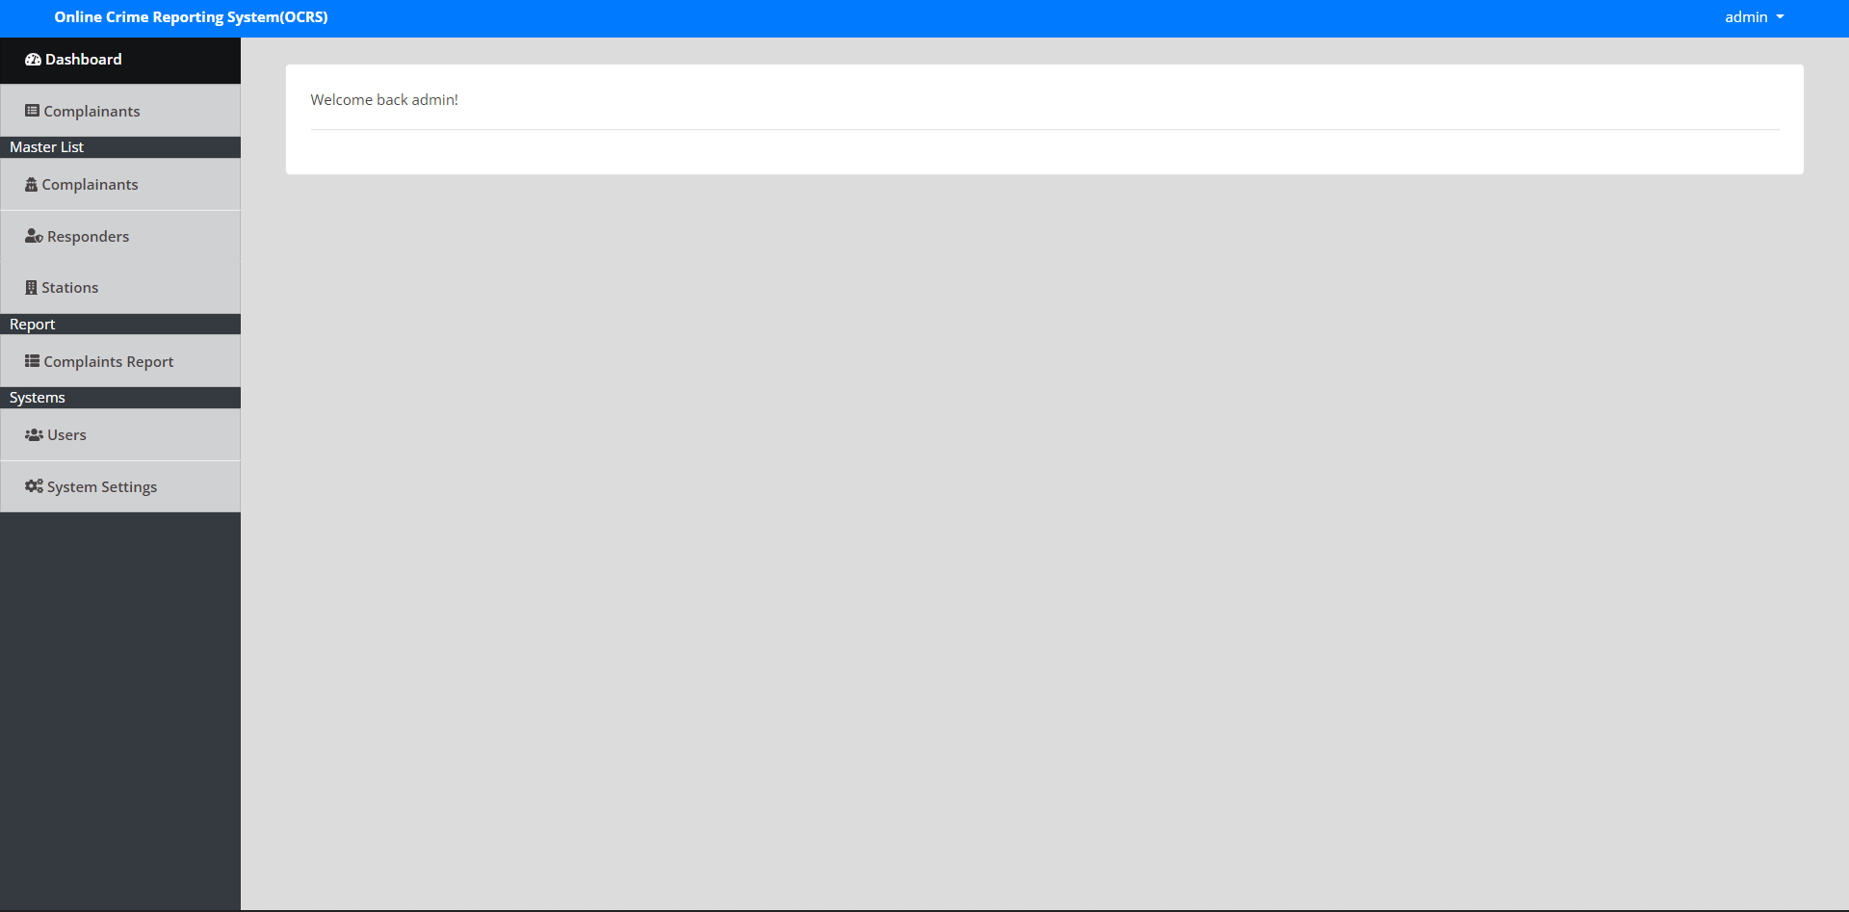
ADMIN DASHBOARDS

Slide 12
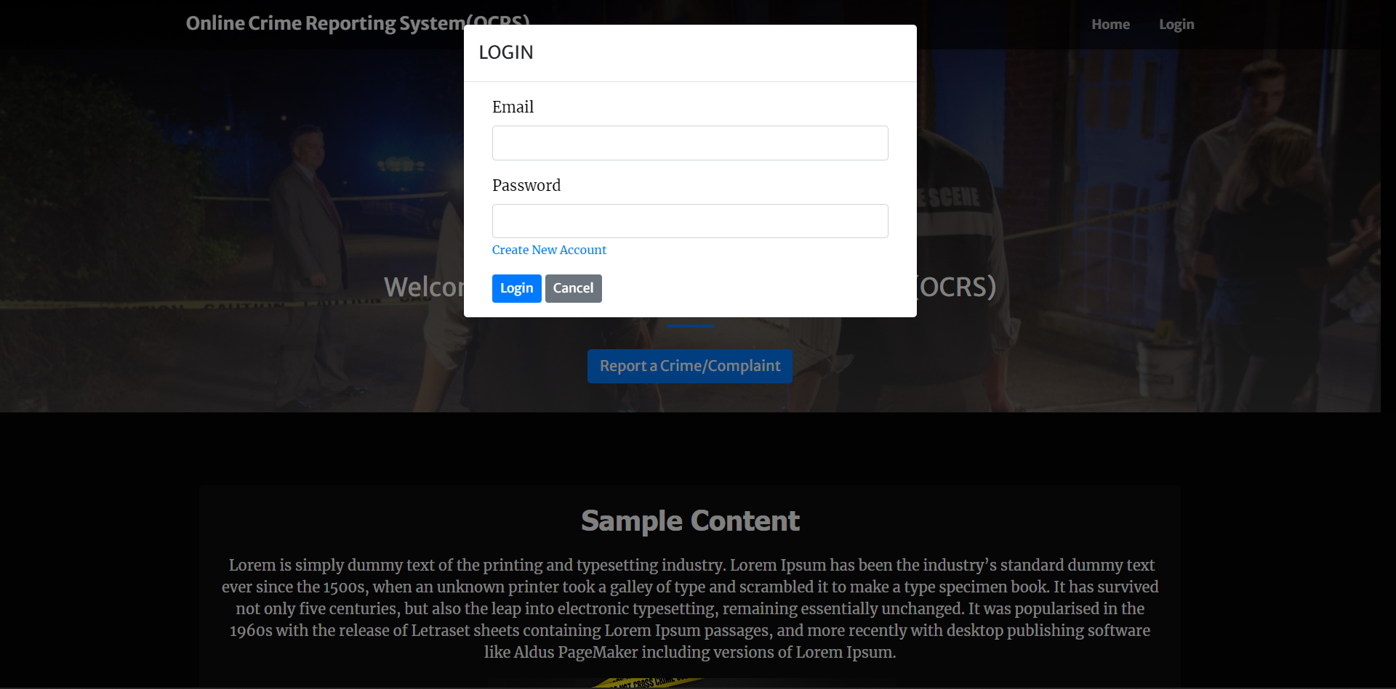
USER LOGIN PAGE

Slide 13
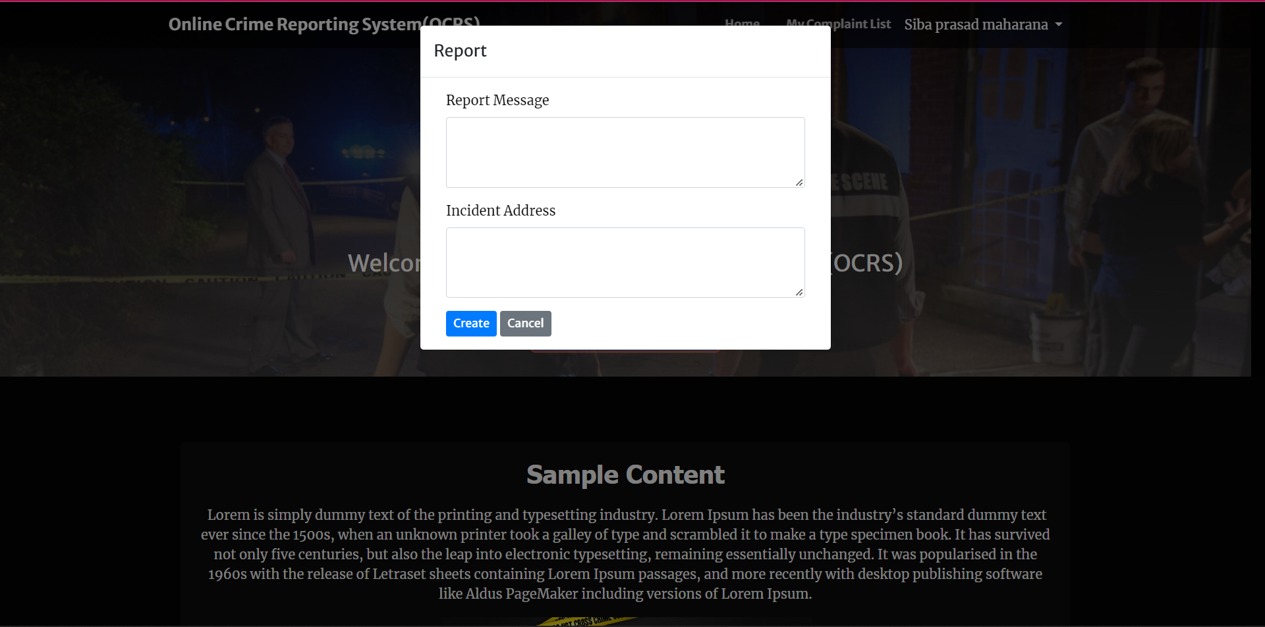
USER REPORTING PAGE

Slide 14
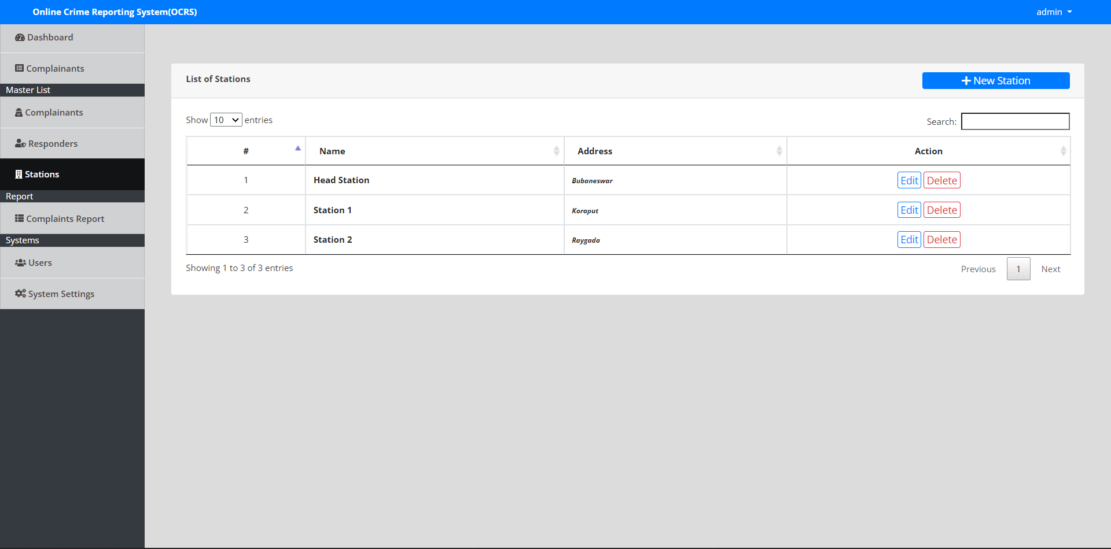
STATIONS FOR ASSIGNING REPORTS

Slide 15
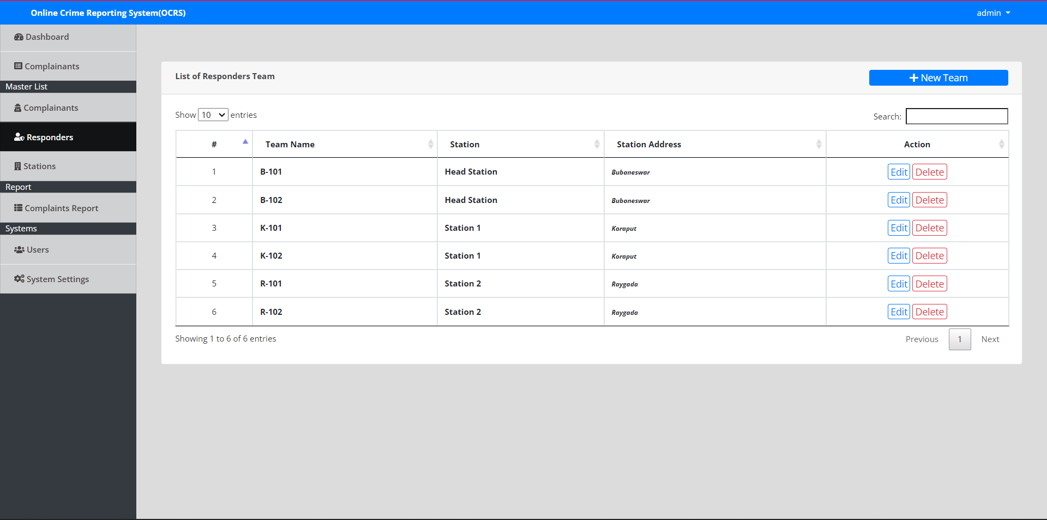
RESPONDERS

Slide 16
CONCLUSION :
The “ONLINE CRIME REPORTING SYSTEM” process was made computerised to reduce human errors and to increase efficiency. The main focus of this project is to lessen human efforts. The maintenance of the records is made efficient, as all the records are stored in the access database, through which data can be retrieved easily.

Slide 17


